Slide 1
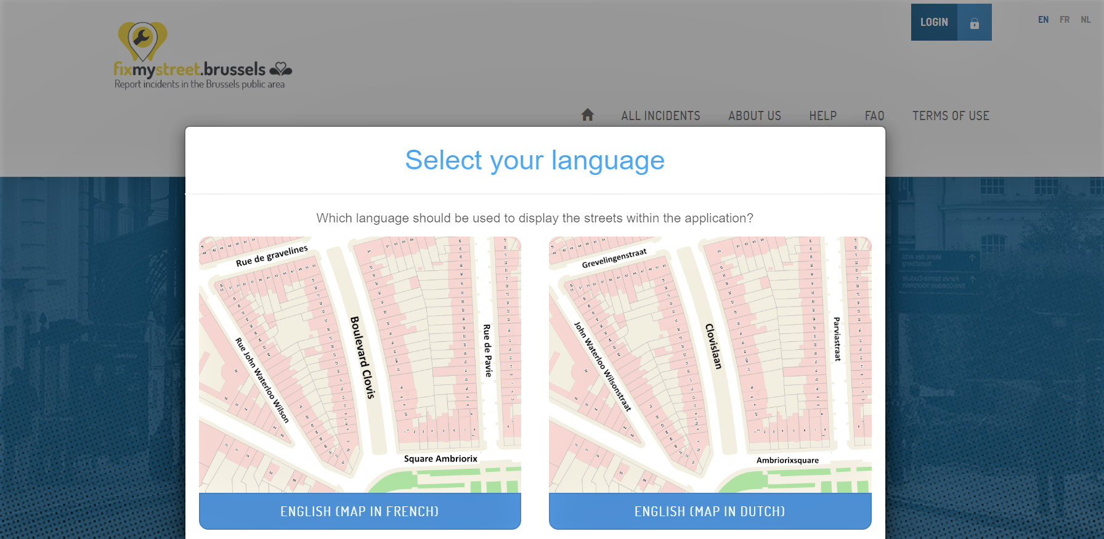
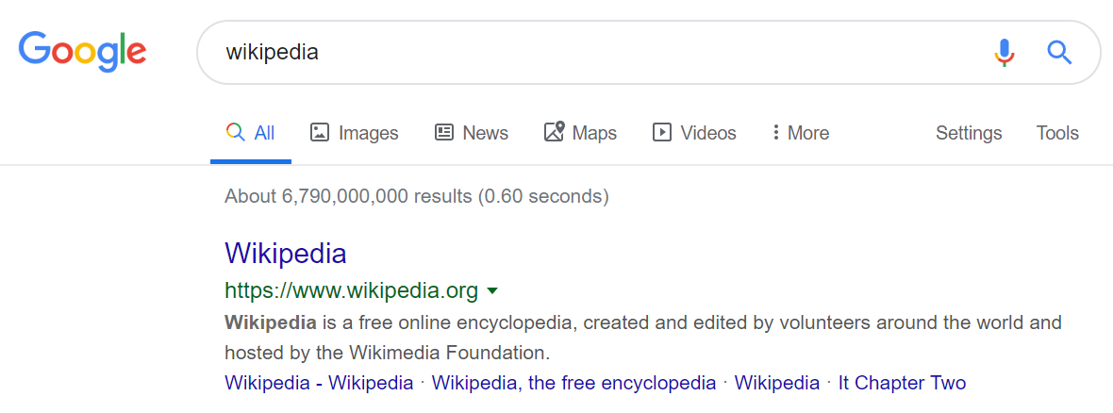
Image credit (Markus Spiske): www.pexels.com/photo/blur-bokeh-business-connection-230860/

Slide 2
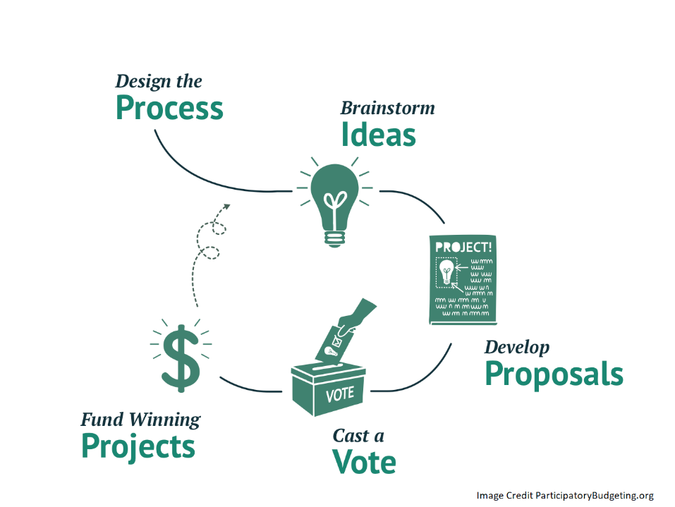
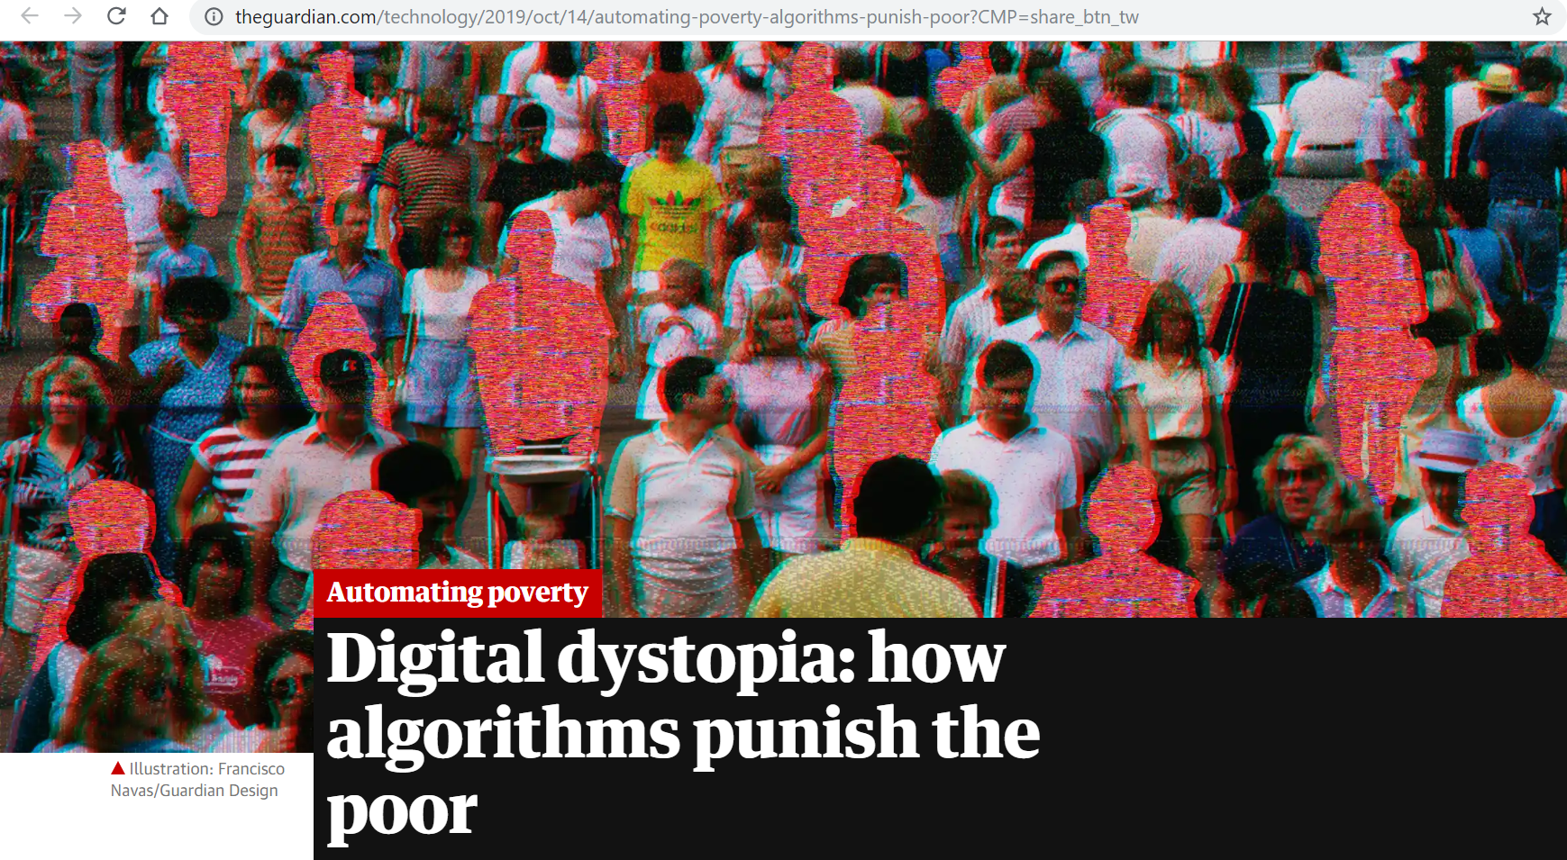
https://www.theguardian.com/technology/2019/oct/14/automating-poverty-algorithms-punish-poor?CMP=share_btn_tw

Slide 3
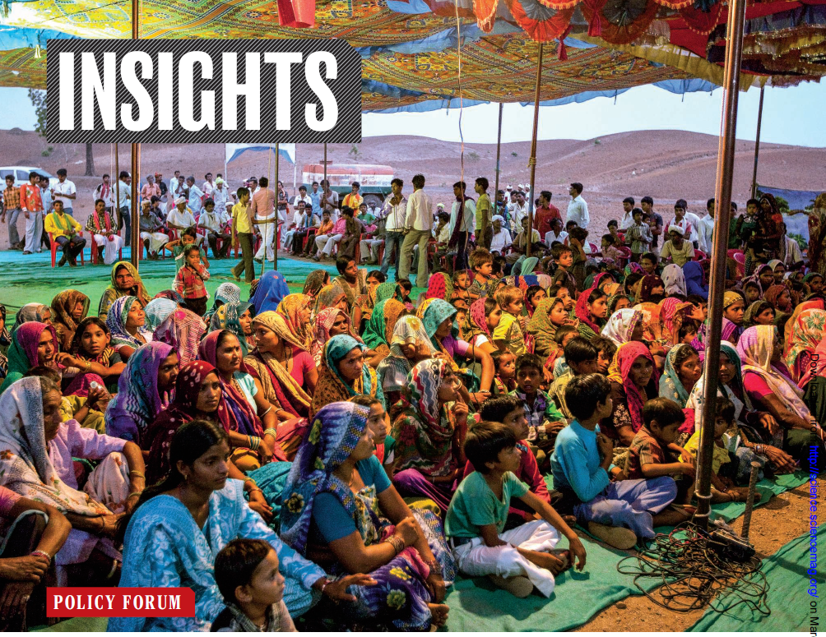
Credit (Science; Jhabua district Madhya Pradesh, India (Gram sabhas): science.sciencemag.org/content/363/6432/1144
Credit (NASA/GSFC): https://www.flickr.com/photos/wwworks/2712985768

Slide 4
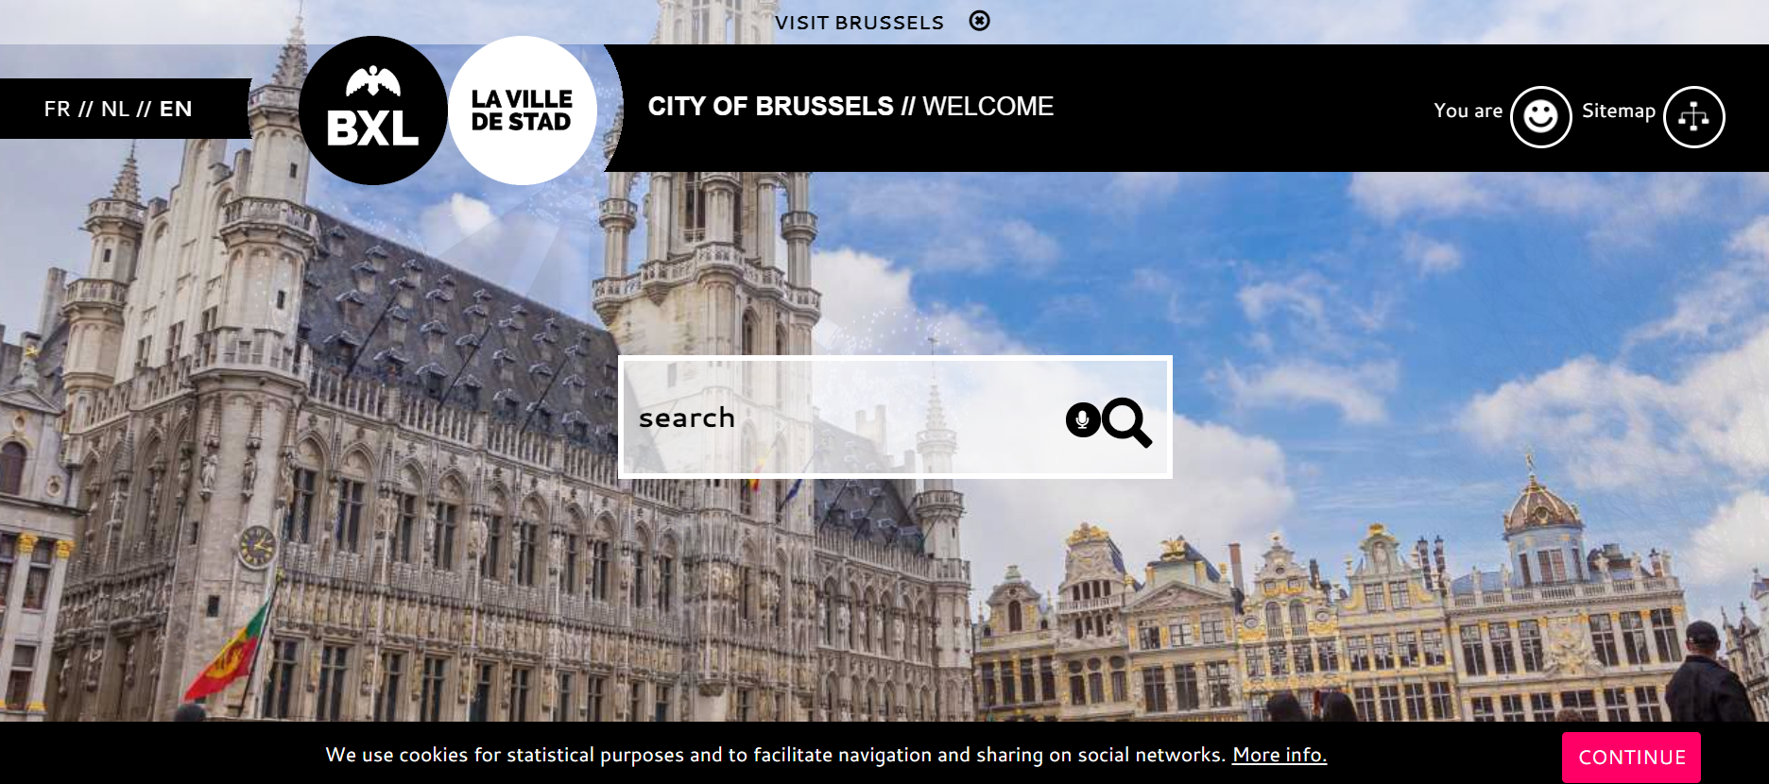
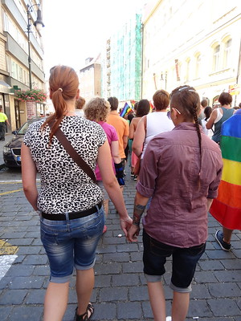
Credits (City of Brussels): www.brussels.be/
Credits (Arda, Flickr): www.flickr.com/photos/23093190@N00/9547864544

Slide 5
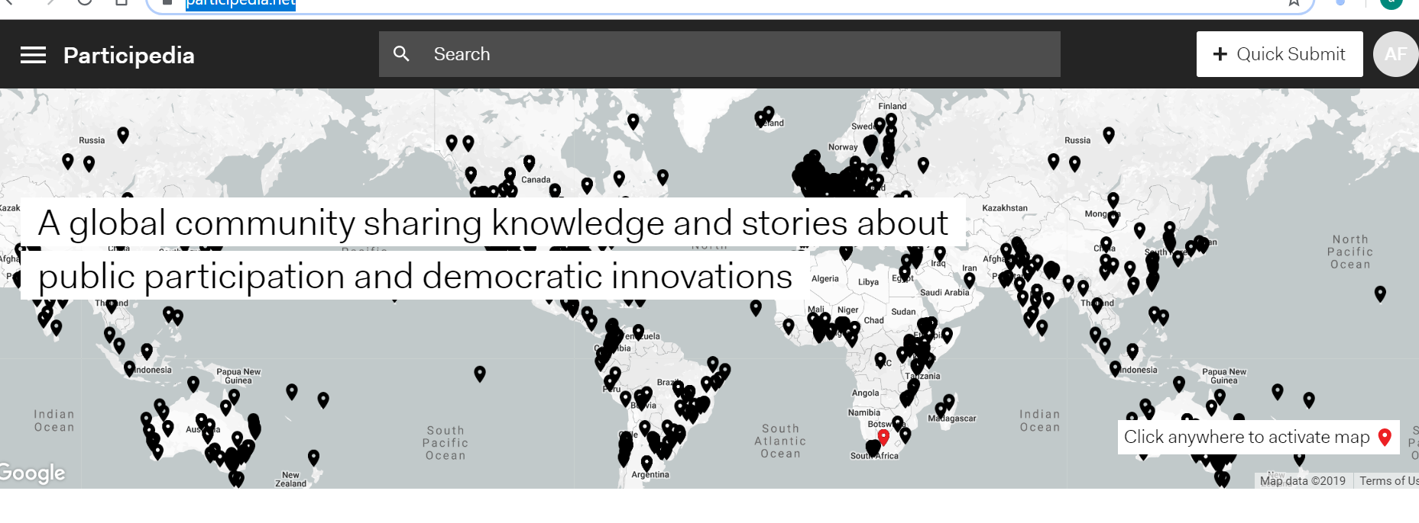
https://participedia.net/

Slide 6
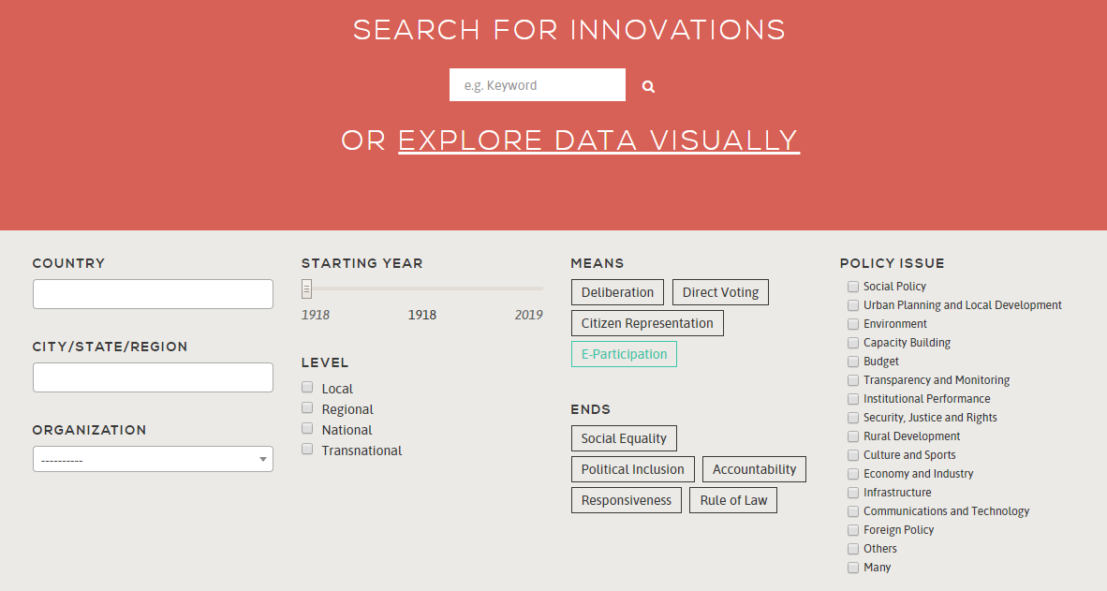
https://www.latinno.net/en/

Slide 7
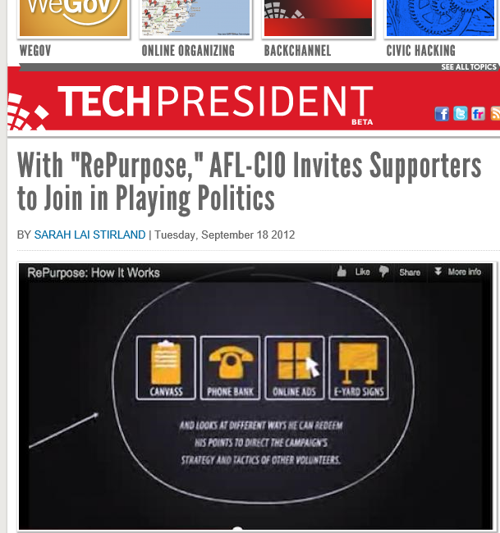

Slide 8
Grazie!
@AndreaFelicetti

